Slide 1

Objectives
In this session, you will learn to:
  Identify the layers in JDBC architecture
  Identify the types of JDBC drivers
  Use the classes and interfaces of JDBC API
  Understand and execute the steps to create JDBC applications

Slide 2
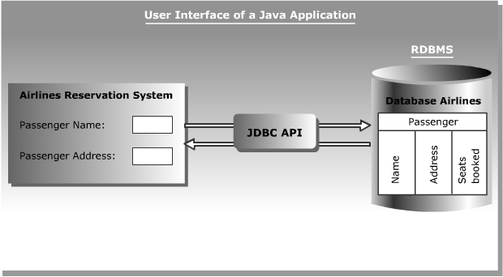
Introducing JDBC
Database Connectivity:
  Sun Microsystems has included JDBC API as a part of J2SDK to develop Java applications that can communicate with databases.
  The following figure shows the Airline Reservation System developed in Java interacting with the Airlines database using the JDBC API:

Slide 3

Database Connectivity
JDBC Architecture:
  Provides the mechanism to translate Java statements into SQL statements.
  Can be classified into two layers:
    JDBC application layer
    JDBC driver layer

Slide 4
Database Connectivity (Contd.)
JDBC Drivers:
  Convert SQL statements into a form that a particular database can interpret.
  Retrieve the result of SQL statements and convert the result into equivalent JDBC API class objects.
  Are of four types:
    JDBC-ODBC Bridge driver
    Native-API Partly-Java driver
    JDBC-Net Pure-Java driver
    Native Protocol Pure-Java driver

Slide 5
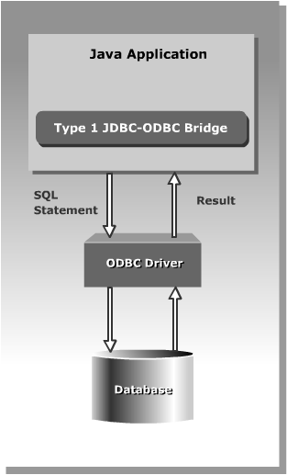
Types of Drivers
JDBC-ODBC Bridge driver:

Slide 6
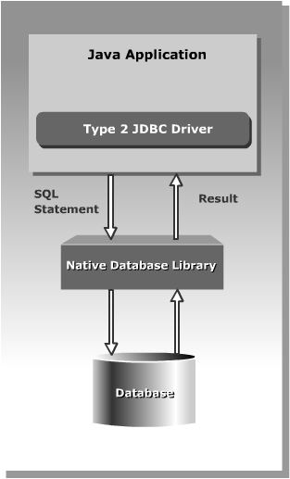
Types of Drivers (Contd.)
Native-API Partly-Java driver:

Slide 7
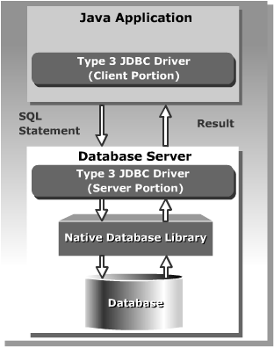
Types of Drivers (Contd.)
JDBC-Net Pure-Java driver:

Slide 8

Types of Drivers (Contd.)
Native-Protocol Pure-Java driver:

Slide 9
Using JDBC API
The JDBC API classes and interfaces are available in the java.sql and the javax.sql packages.
The commonly used classes and interfaces in the JDBC API are:
  DriverManager class: Loads the driver for a database.
  Driver interface: Represents a database driver. All JDBC driver classes must implement the Driver interface.
  Connection interface: Enables you to establish a connection between a Java application and a database.
  Statement interface: Enables you to execute SQL statements.
  ResultSet interface: Represents the information retrieved from a database.
  SQLException class: Provides information about the exceptions that occur while interacting with databases.

Slide 10
Creation of a JDBC Application
Steps to create a JDBC application are:
  Load a driver
  Connect to a database
  Create and execute JDBC statements
  Handle SQL exceptions

Slide 11
Loading a Driver
Driver can be loaded:
  Programmatically:
    Using the forName() method
    Using the registerDriver()method
  Manually:
    By setting system property

Slide 12
The forName() Method
Using the forName() method:
  The forName() method is available in the java.lang.Class class.
  The forName() method loads the JDBC driver and registers the driver with the driver manager.
  The method call to use the the forName() method is:
    Class.forName("com.microsoft.sqlserver.jdbc.SQLServerDriver");

Slide 13
The registerDriver() Method
Using the registerDriver() method:
  You can create an instance of the Driver class to load a JDBC driver.
  This instance enables you to provide the name of the driver class at run time.
  The statement to create an instance of the Driver class is:
    Driver d = new com.microsoft.sqlserver.jdbc.SQLServerDriver();
  You need to call the registerDriver() method to register the Driver object with the DriverManager.
  The method call to register the Type 4 driver is:
    DriverManager.registerDriver(d);

Slide 14
Setting System Property
Steps to set the System Property:
  Add the driver name to the jdbc.drivers system property to load a JDBC driver.
  Use the –D command line option to set the system property on the command line.
  The command to set the system property is:
    java –Djdbc.drivers= com.microsoft.sqlserver.jdbc.SQLServerDriver SampleApplication

Slide 15
Connecting to a Database
Connecting to a Database:
  The DriverManager class provides the getConnection() method to create a Connection object.
  The getConnection() method method has the following three forms:
    Connection getConnection (String <url>)
    Connection getConnection (String <url>, String <username>, String <password>)
    Connection getConnection (String <url>, Properties <properties>)

Slide 16
Creating and Executing JDBC Statements
JDBC Statements can be created and executed as follows:
  The Connection object provides the createStatement() method to create a Statement object.
  You can use static SQL statements to send requests to a database to retrieve results.
  The Statement interface contains the following methods to send static SQL statements to a database:
    ResultSet executeQuery(String str)
    int executeUpdate(String str)
    boolean execute(String str)

Slide 17
Database Operations
Various database operations that you can perform using a Java application are:
  Querying a table
  Inserting rows in a table
  Updating rows in a table
  Deleting rows from a table
  Creating a table
  Altering and dropping a table

Slide 18
Querying a Table
In order to query a table:
  The SELECT statement is executed using the executeQuery() method and returns the output in the form of a ResultSet object.
  The code snippet to retrieve data from the Authors table is:
    String str = "SELECT * FROM Authors";
    Statement stmt = con.createStatement();
    ResultSet rs = stmt.executeQuery(str);

Slide 19
Inserting Rows in a Table
In order to insert rows in a table:
  The executeUpdate() method enables you to add rows in a table.
  The code snippet to insert a row in the Authors table is:
    String str = " INSERT INTO Authors (au_id, au_name, phone, address, city, state, zip) VALUES (‘a004’, ‘Ringer Albert’, ‘8018260752’, ‘ 67 Seventh Av.’, ‘Salt Lake City’, ‘UT’, ’100000078’)";
    Statement stmt = con.createStatement();
    int count = stmt.executeUpdate(str);

Slide 20
Updating and Deleting Rows in a Table
The code snippet to modify a row in the Authors table is:
  String str = "UPDATE Authors SET address='10932 Second Av.’ WHERE au_id=‘a001’";
  Statement stmt = con.createStatement();
  int count = stmt.executeUpdate(str);
The code snippet to delete a row from the Authors table is:
  String str = "DELETE FROM Authors WHERE au_id=‘a005’";
  Statement stmt = con.createStatement();
  int count = stmt.executeUpdate(str);

Slide 21
Creating a Table
The CREATE TABLE statement is used to create and define the structure of a table in a database.
The code snippet to create a table is:
  String str="CREATE TABLE Publishers"
  +"(pub_id VARCHAR(5),"
  +"pub_name VARCHAR(50),"
  +"phone INTEGER,"
  +"address VARCHAR(50), "
  +"city VARCHAR(50), "
  +"ZIP VARCHAR(20))";
  Statement stmt=con.createStatement();
  stmt.execute(str);

Slide 22
Altering and Dropping a Table
DDL provides the ALTER statement to modify the definition of database object.
The code snippet to add a column to the Books table is:
  String str="ALTER TABLE Books “+"ADD price INTEGER";
  Statement stmt=con.createStatement();
  stmt.execute(str);
DDL provides the DROP TABLE statement to drop a table from a database.
The code snippet to drop the Books table from a database is:
  String str="DROP TABLE Books";
  Statement stmt=con.createStatement();
  stmt.execute(str);

Slide 23
Handling SQL Exceptions
SQL Exceptions can be handled as follows:
  The java.sql package provides the SQLException class, which is derived from the java.lang.Exception class.
  You can catch the SQLException in a Java application using the try and catch exception handling block.
  The SQLException class contains various methods that provide error information, these methods are:
    int getErrorCode(): Returns the error code associated with the error occurred.
    String getSQLState(): Returns X/Open error code.
    SQLException getNextException(): Returns the next exception in the chain of exceptions.

Slide 24
Accessing Result Sets
A ResultSet object maintains a cursor that enables you to move through the rows stored in a ResultSet object.
The various types of ResultSet objects to store the output returned by a database are:
  Read only: Allows you to only read the rows in a ResultSet object.
  Forward only: Moves the result set cursor from first row to last row in forward direction only.
  Scrollable: Moves the result set cursor forward or backward through the result set.
  Updatable: Allows you to update the result set rows retrieved from a database table.

Slide 25
Accessing Result Sets (Contd.)
The following table lists various fields of ResultSet interface that you can use to specify the type of a ResultSet object:
ResultSet Fields
Description
TYPE_SCROLL_SENTITIVE
Specifies that the cursor of the ResultSet object is scrollable and it reflects the changes in the data made by other users.
TYPE_SCROLL_INSENSITIVE
Specifies that the cursor of the ResultSet object is scrollable and it does not reflect changes in the data made by other users.
TYPE_FORWARD_ONLY
Specifies that the cursor of the ResultSet object moves in forward direction only from the first row to the last row.

Slide 26
Accessing Result Sets (Contd.)
The following table lists various fields of the ResultSet interface that you can use to specify different concurrency modes of result sets:
ResultSet Fields
Description
CONCUR_READ_ONLY
Specifies the concurrency mode that does not allow you to update the ResultSet object.
CONCUR_UPDATABLE
Specifies the concurrency mode that allows you to update the ResultSet object.

Slide 27
The createStatement() method
The createStatement() method has the following three overloaded forms:
  Statement createStatement()
  Statement createStatement(int, int)
  Statement createStatement(int, int, int)

Slide 28
Methods of ResultSet Interface
The following tables lists the methods of ResultSet interface:
Method
Description
boolean first()
Shifts the control of a result set cursor to the first row of the result set.
boolean isFirst()
Determines whether the result set cursor points to the first row of the result set.
boolean beforeFirst()
Shifts the control of a result set cursor before the first row of the result set.
boolean isBeforeFirst()
Determines whether the result set cursor points before the first row of the result set.
boolean last()
Shifts the control of a result set cursor to the last row of the result set.
boolean isLast()
Determines whether the result set cursor points to the last row of the result set.

Slide 29
Methods of ResultSet Interface (Contd.)
The methods of ResultSet interface (Contd.):
Method
Description
boolean afterLast()
Shifts the control of a result set cursor after the last row of the result set.
boolean isAfterLast()
Determines whether the result set cursor points after the last row of the result set.
boolean previous()
Shifts the control of a result set cursor to the previous row of the result set.
boolean absolute(int i)
Shifts the control of a result set cursor to the row number that you specify as a parameter.
boolean relative(int i)
Shifts the control of a result set cursor, forward or backward, relative to the row number that you specify as a parameter.

Slide 30
Methods of ResultSet Interface (Contd.)
JDBC allows you to create an updatable result set that enables you to modify the rows in the result set.
The following table lists some of the methods used with updatable result set:
Method
Description
void updateRow()
Updates a row of the current ResultSet object and the underlying database table.
void insertRow()
Inserts a row in the current ResultSet object and the underlying database table.
void deleteRow()
Deletes a row from the current ResultSet object and the underlying database table.
void updateString()
Updates the specified column with the given string value.
void updateInt()
Updates the specified column with the given int value.

Slide 31
Demo: Creating a JDBC Application to Query a Database
Problem Statement:
  Create an application to retrieve information (author id, name, phone, address, city, state, and zip ) about the authors who are living in the city where the city name begins with the letter “S”.

Slide 32
Demo: Creating a JDBC Application to Query a Database (Contd.)
Solution:
  Type 4 driver is to be used for creating the application. To solve the above problem, perform the following tasks:
    Create a Data Source Name (DSN).
    Code the application.
    Compile and execute the application.

Slide 33
Summary
In this session, you learned that:
  JDBC Architecture consists of two layers:
    JDBC application layer: Signifies a Java application that uses the JDBC API to interact with the JDBC driver manager.
    JDBC driver layer: Contains a driver, such as an SQL Server driver, which enables a Java application to connect to a database. This layer acts as an interface between a Java application and a database.
  The JDBC driver manager manages various JDBC drivers.
  The JDBC driver is software that a Java application uses to access a database.
  JDBC supports four types of drivers:
    JDBC-ODBC Bridge driver
    Native-API Partly-Java driver
    JDBC-Net Pure-Java driver
    Native Protocol Pure-Java driver

Slide 34
Summary (Contd.)
  The JDBC API consists of various classes and interfaces that enable Java applications to interact with databases.
  The classes and interfaces of the JDBC API are defined in the java.sql and javax.sql packages.
  You can load a driver and register it with the driver manager either programmatically or manually.
  Two ways to load and register a driver programmatically are:
    Using the Class.forName() method
    Using the registerDriver() method
  You can add the driver name to the jdbc.drivers system property to load and register a JDBC driver manually.
  A Connection object establishes a connection between a Java application and a database.
  A Statement object sends requests to and retrieves results from a database.

Slide 35
Summary (Contd.)
  You can insert, update, and delete data from a table using the DML statements in Java applications.
  You can create, alter, and drop tables from a database using the DDL statements in Java applications.
  A ResultSet object stores the result retrieved from a database when a SELECT statement is executed.
  You can create various types of ResultSet objects such as read only, updatable, and forward only.

